Slide 1
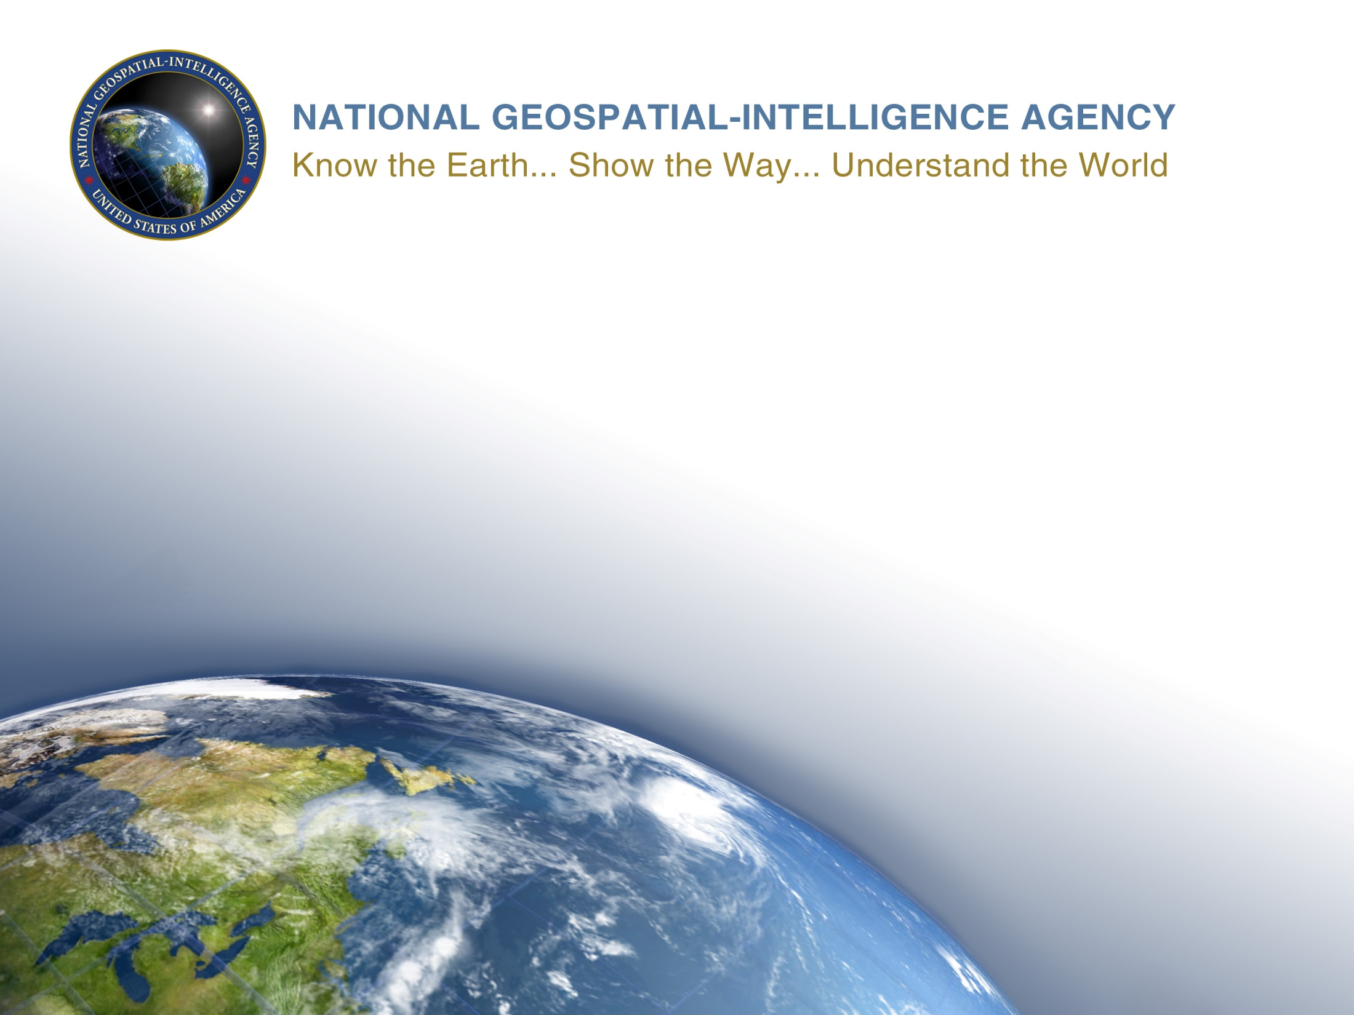
Polar Ice Sources (NIPWG Action Item 2-11)
Michael Kushla (NGA)/Ludovico Sturla (IHI)
7 December 2016
1

Slide 2
UNCLASSIFIED
The National Geospatial-Intelligence Agency (NGA) and the Italian Hydrographic Institute (IHI) were tasked to research availability of ice information from countries bordering the polar regions or with a significant scientific or commercial presence in the Arctic and Antarctic regions and whether this information would be relevant to NIPWG test data sets.
2
UNCLASSIFIED

Slide 3
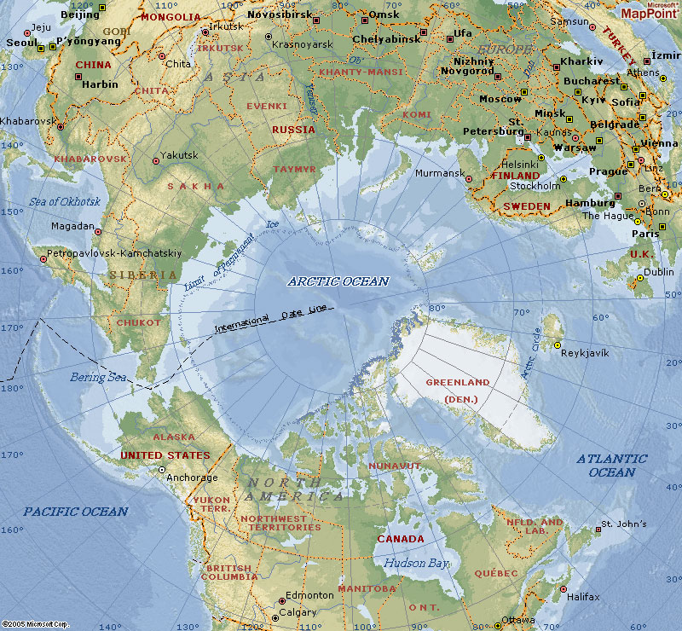
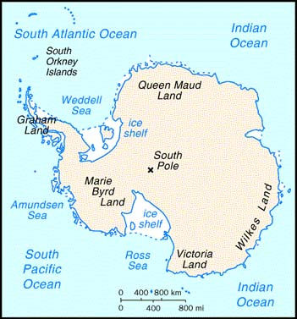
We concentrated on researching information from Australia, Canada, Denmark/Greenland, Germany, Iceland, Norway, Russia, the United Kingdom, and the United States.

Slide 4
UNCLASSIFIED
The initial research effort was divided into two topics:
Historical information—A summary of data collected over a period of time. Can be obtained from both hard copy hydrographic office sailing directions and pilots as well as from hydrographic office, scientific, educational, and commercial web sites on the internet.
Real-time information—Data reflecting what is happening at the current time and predictions for the short-term future. Can be obtained from hydrographic office, scientific, educational, and commercial web sites on the internet as well as through telephone, facsimile, and e-mail requests through these same web sites.
4
UNCLASSIFIED

Slide 5
UNCLASSIFIED
A significant number of sources (almost 50) are available, either in hard-copy format or via the internet, covering historical and real-time data regarding ice information in the Arctic and the Antarctic polar regions.
The breakdown of this information can be summarized, as follows:
Historical information vs. real-time information.
Arctic region vs. Antarctic region.
Hard copy availability vs. internet availability.
5
UNCLASSIFIED

Slide 6
Summary of Historical Data
Source Country | Arctic |  | Antarctic
 | Internet | Hard Copy | Hard Copy
Australia |  |  | 1
Canada | 2 | 1
Denmark (Greenland) | 1
Germany | 1
Iceland | 1
Norway | 1 | 1
Russia | 1
United Kingdom |  | 6 | 2
United States | 3 | 5 | 1
Total Sources | 10 | 13 | 4

Slide 7
Summary of Real-time Sources
Source Country | Arctic | Antarctic
 | Internet | Internet
Australia |  | 1
Canada | 1
Denmark (Greenland) | 2
Germany | 2 | 1
Iceland | 1
Norway | 1
Russia | 2
United Kingdom
United States | 6 | 3
Total Sources | 15 | 5

Slide 8
Summary
Annex A lists sources, available in hard copy format and on the internet, for historical ice information for the Arctic and the Antarctic.
Annex B lists internet sources which provide real-time ice information for the Arctic and the Antarctic.
This paper should be reviewed by Wilfred den Toom for possible inclusion in the Physical Environment Test Data Set.

Slide 9
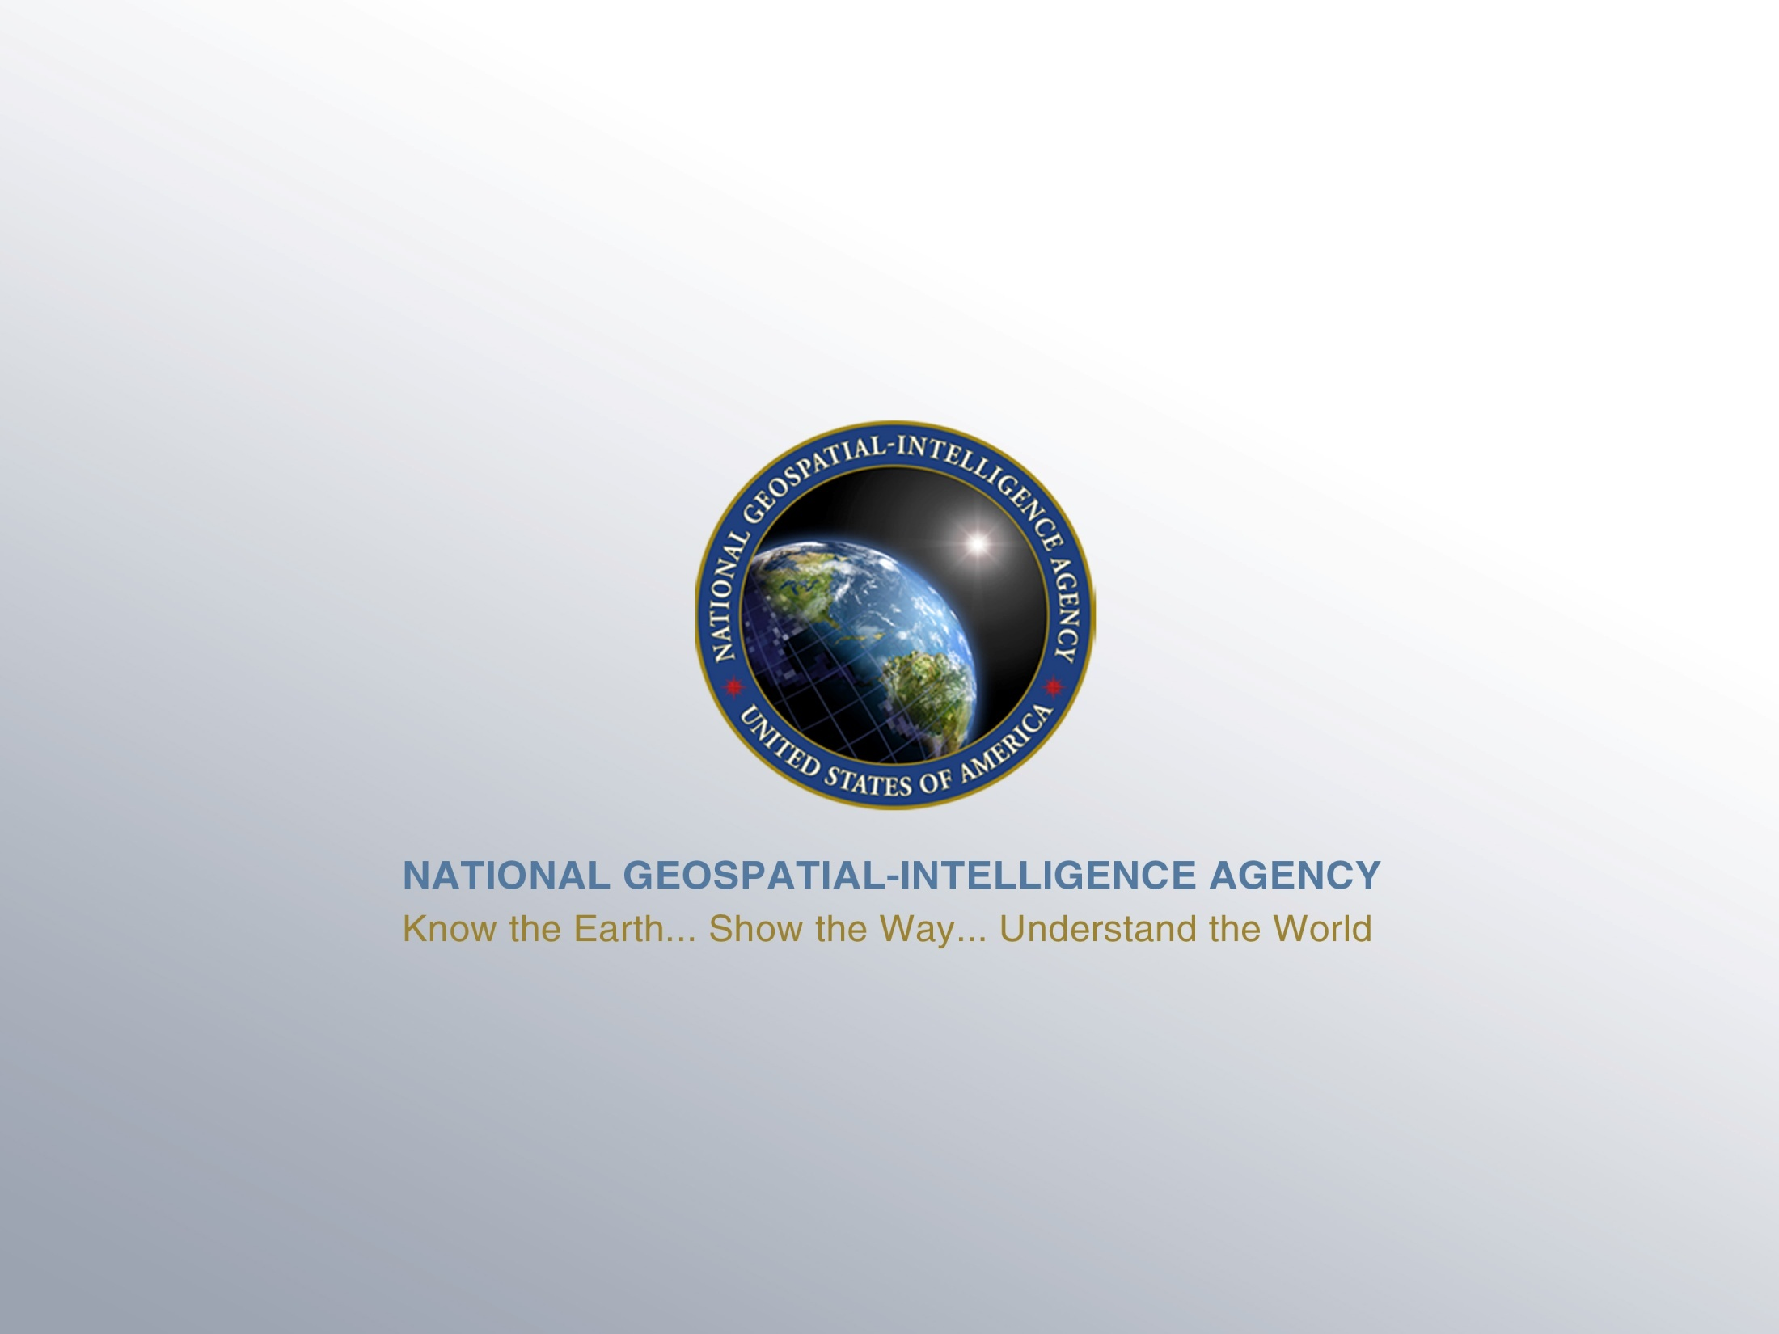
UNCLASSIFIED
9
UNCLASSIFIED

